Slide 1
LENDING CLUB CASE STUDY ASSIGNMENT SUBMISSION
Name: Akshay Jindal, Bighnesh Mishra

Slide 2
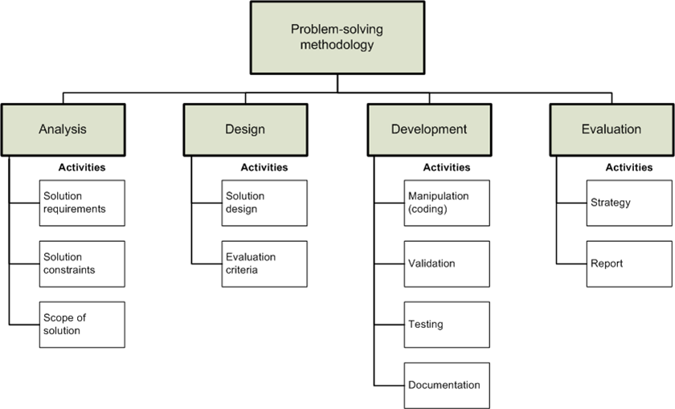
Problem Solving Methodology

Slide 3
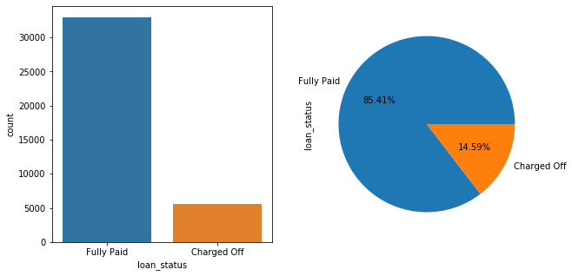
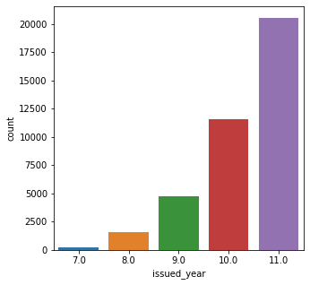
Increase of loan distribution over the years
The study has been performed on data-set (2007-2011) in which 14.59 % of Charged Off users exist
Over the years the loan distribution also increased. A huge boost can be seen in year 2011.

Slide 4
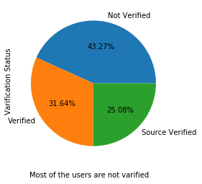
Loan verification status of verified and
non-verified borrowers
Most of the loan users are not variefied. It could be a fector of increasing Charged Off users.
5.55 % Charged Off users are not variefied.
Verification status | Not Verified | Source Verified | Verified
Loan status
Charged Off | 5.55 | 3.72 | 5.32
Fully Paid | 37.72 | 21.37 | 26.32

Slide 5
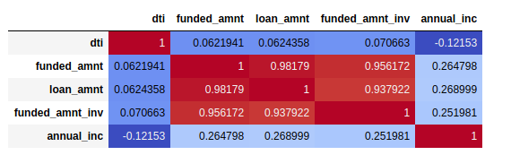
Correlation between loan attributes
1. The above table a very positive correlation can be seen between funded amount and loan amount.
2. The positive relation between loan amount and amount funded by the investors.
i,e The amount whatever recommeded by the landing culb most of the time insvestors also issue the same or a little less amount to the borrower.
3. A negetive relation between DTI and annual income. i.e increment in the DTI decreases the annual income.

Slide 6
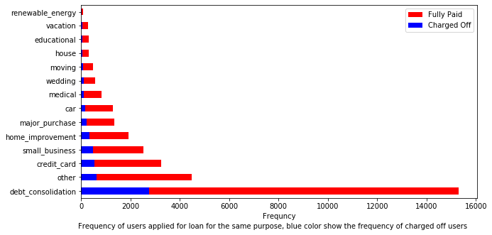
Users’ purpose of taking loan
Here the blue line indicates the Charged Off users.
Red line indicates the count of Fully paid users.
Most of the users had taken loan for the purpose of debt consolidation.
The top three purposes are as follow:
1. Debt Consolidation
2. Other
3. Credit Card.
Notes:
Here the blue line indicates the Charged Off users.
Red line indicates the count of Fully paid users.
Most of the users had taken loan for the purpose of debt consolidation.
The top three purposes are as follow:
1. Debt Consolidation
2. Other
3. Credit Card.

Slide 7
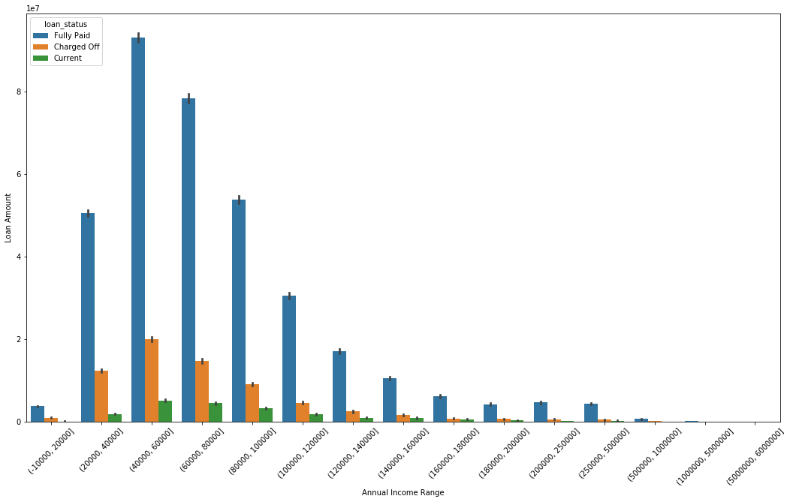
Annual income range which holds the maximum number of defaulters
Most of the defaulters lie between the income range of 40K to 60K.
Top three defaulter income categories:
1. 20k-40k
2. 40k-60k
3. 60k-80k

Slide 8
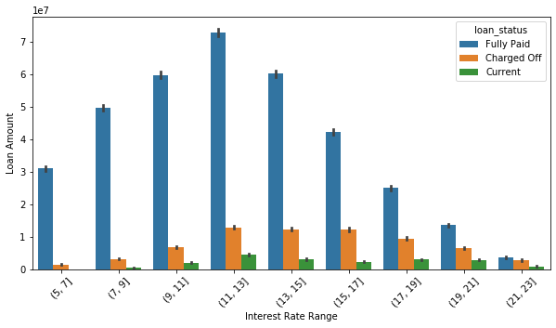
Interest rate in which the highest number of defaulters lie
Plot 3
The above figure shows that most of the defaulters are lying in the interest range of 11 to 21.

Slide 9
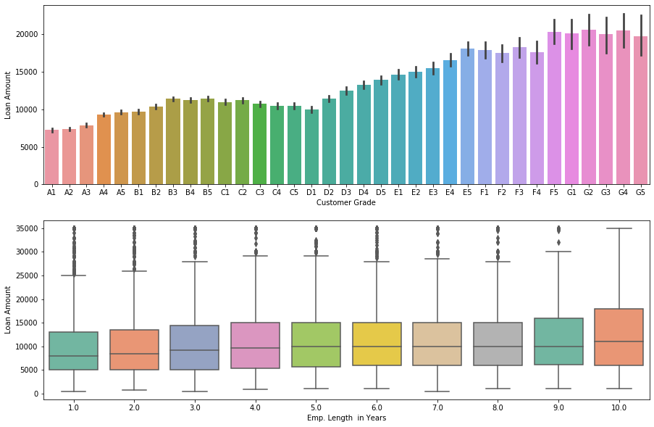
Loan amount issued to the sub grade and employment length
Figure1 .
Display how the loan amount distributed between differnt different sub grades.
Most of the about is issued to sub grade G1,G2 .. and so on.
Figure 2.
Shows that the 10 & 10+ years employment length received the maximum loan amount.
Loan amount is almost equally distributed between 25 and 75 percentile. Except the 10 years emplyment length

Slide 10
Top 9 US states in which most of the defaulters lie
Addr State | CA | FL | GA | AZ | CO | CT | AL | HI | AR
Charged Off | 7.89% | 3.53% | 1.51% | 0.86% | 0.69% | 0.66% | 0.38% | 0.20% | 0.19%
Fully Paid | 40.82% | 15.96% | 8.02% | 5.09% | 4.68% | 4.43% | 2.67% | 0.97% | 1.46%
Most of the defaulters are based from the CA and FL states.

Slide 11
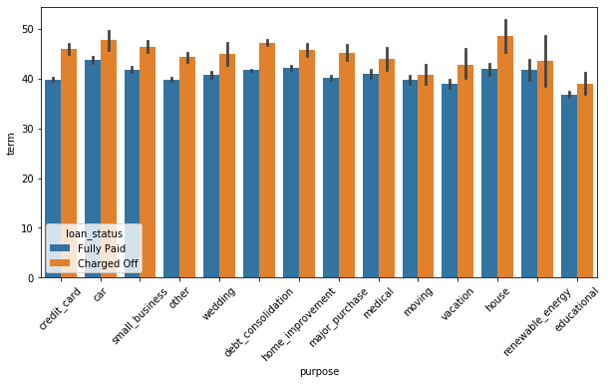
Plot between loan term and purpose
All the defaulters had applied for long term loan period.
1. The yellow bar denotes the Charged off users loan term
2. The blue bar refers to the Fully Paid user loan term.

Slide 12
Conclusions
From the analysis, it is found that the following univariate and bivariate variable can play a vital role to identify the defaulters. Variables are as follow :
Verification Status
As seen in the graph ~42% people were not verified. The borrower should come from a verified source.
Employment Length
The employment length is higher for the defaulters.
Interest Rate
Interest is higher for the defaulters.
DTI
DTI is higher for the defaulters
Annual Income
Annual income is lower for the defaulters
Term
Most of them has applied for a higher term i.e 60 months
Grade
Sub grade G has the highest number of defaulters.
Address State
Most of the defaulter are living in California, Florida

